Slide 1
RYSE: Characters In Focus
Riham Toulan Technical Artist

Slide 2
Session Overview
In this session we will have a closer look at :
Ryse character rigging pipeline.
Character physics and Secondary animations
Examples of useful rigging tools developed along production.

Slide 3
Moving the pipeline to Maya
About 2o unique characters without variations
Limited resources
Has to be Fast, efficient and modular
Notes:
Ryse is a game about characters, and our goal (technical art team) was to bring these characters to life and push the bar of games characters quality.It was just the right time to move the pipelines to Maya.

Slide 4
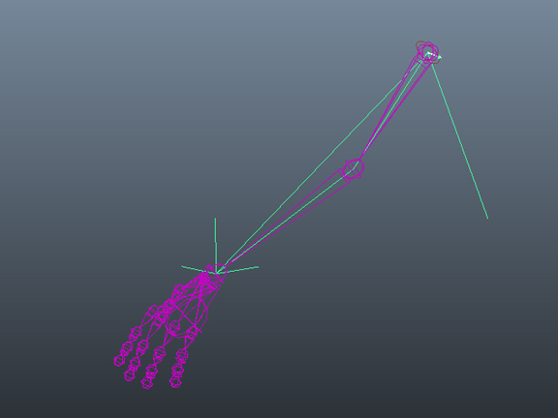
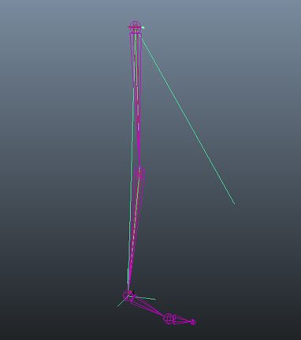
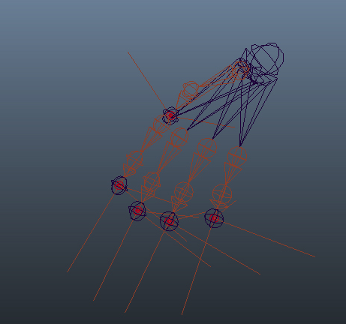
Modular Rigging Pipeline
Python generated Modular Rigging
Modular Rigging : The process of creating similar rig components that can be used on different body parts and skeleton types
Notes:
Modular Rigging: is the concept of automatically creating similar rig components for different body parts on different skeleton types. , for example an Ik chain can be used for a leg or an arm or even a finger.
However, The granularity of the modules is a big design decision.

Slide 5
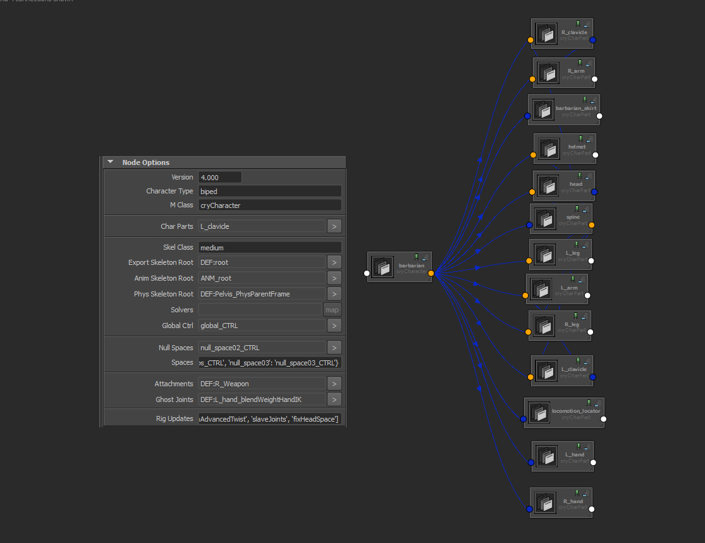
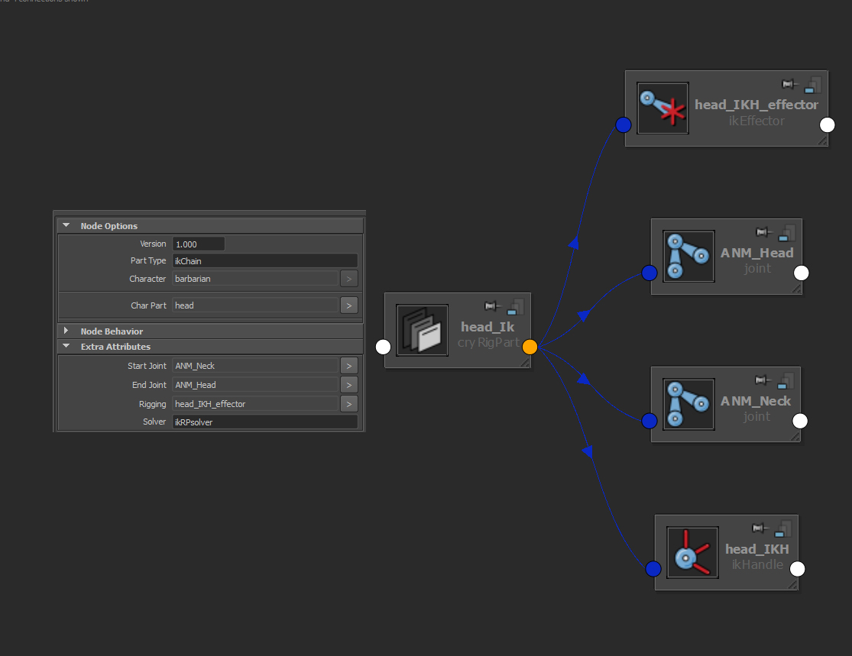
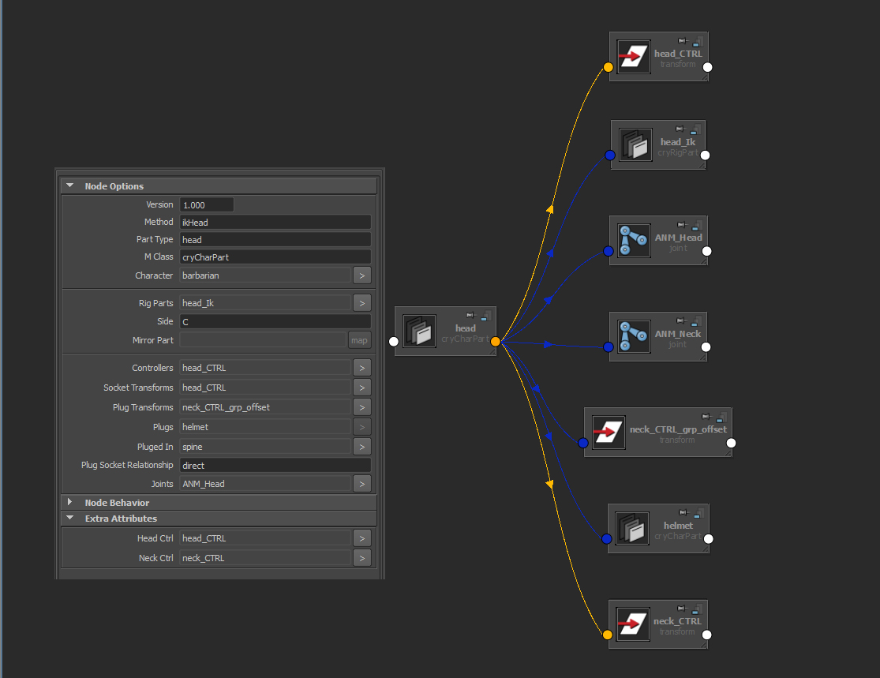
Custom Nodes
Maya plug-in
Rig Parts
Character Parts
Character
Notes:
The way we organized the rigging components in our system was through three parts. A rigpart, character part and the character built with a custom node.
Starting with the smallest component a rig part.
An example of a rig part would be an ik chain. Rig parts hold information about the type of the used solvers, the ikhandle start joint, end joint and of course their parent. Which would be a character part.
In the example above we have a head character part. Now a character part would hold information about the controllers, what side of the body this part is, all the joints involved in the rig and of course its parent character.
Finally a character. This part holds more general information about the character rig, like the type (quadruped or biped or even prop), animation skeleton, export skeleton , all the spaces available on the character and a list of the updates that has been pushed on the character so far.

Slide 6
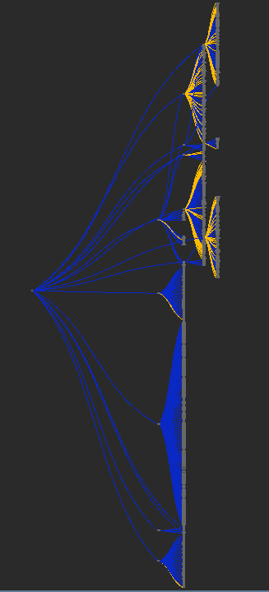
Metadata Framework
Metadata Node Network
Describes the relationships between nodes
Keeps track of data
Easier to make rigging and animations tools
Notes:
All of these connections are added and managed through a meta network, and metadata it self means information. You are adding information about the relationship between the rigging nodes and also keeping track of data that you may need later for other rigging module.

Slide 7
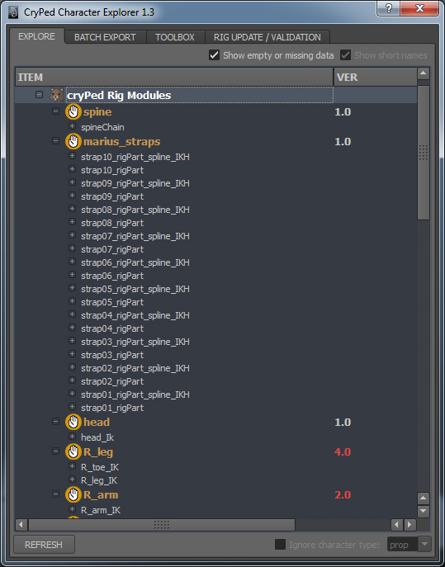
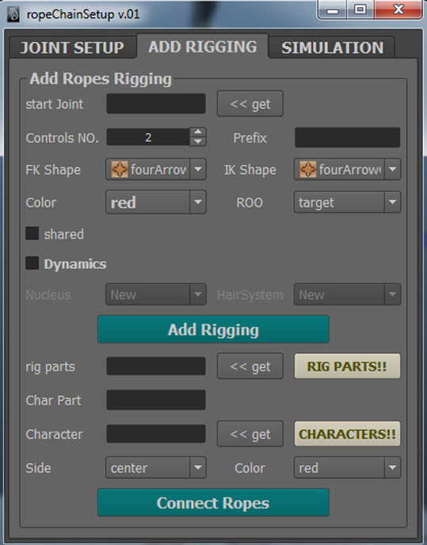
Tool Examples
Notes:
Examples of the tools we built using the system, Animtool box which acted as a rig interface. it works on every character rig we have and miraculously the animators stopped asking for a GUI ever since.
We also built the CryPed character explorer tool to keep track of all made rigging parts. We can also through the tool export characters to the engine, and add our rig pdates.
Another Rigging tool is the RopeChainSetup tool and we used this one to build all kind of rope like setups. Like Glott dreadlocks and tail, Boudica‘s pony tail and all Romans straps.

Slide 8
Advantages:
Instant Creation
Rigs consistency Marking Menus, space switching, Ik/Fk snap etc..
Fast iterations
One tool set
Multiple copies of the rig in one secene

Slide 9
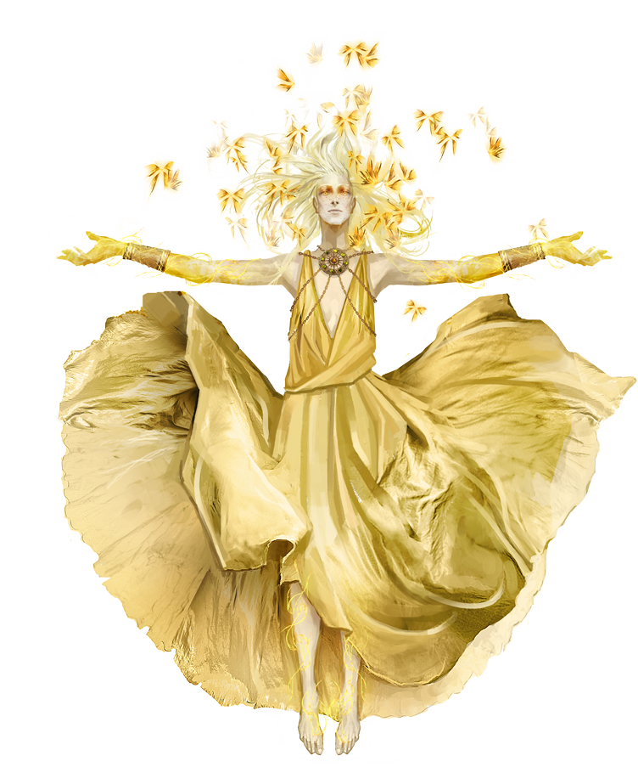
Character Physics
Secondary Animations & Cloth

Slide 10
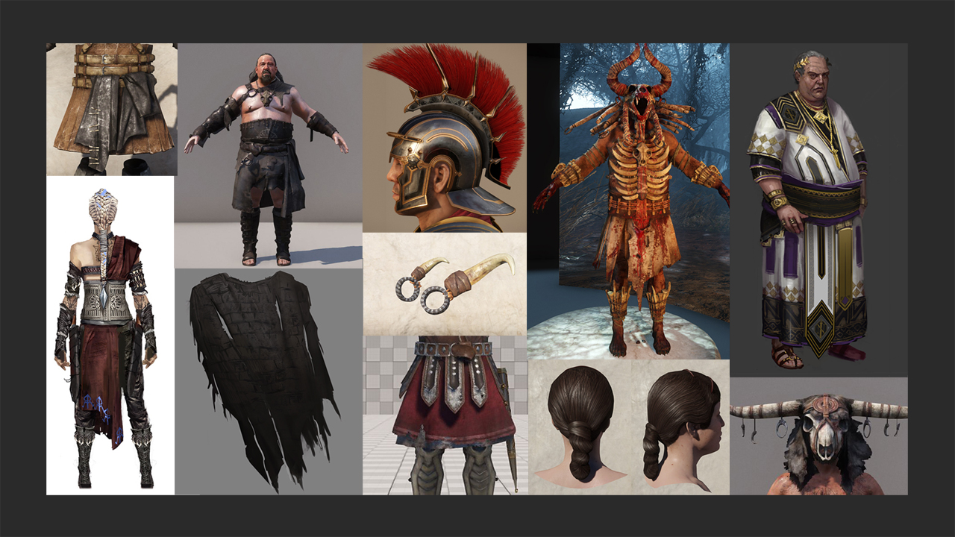
Notes:
Video. Here are some gameplay examples from Ryse.
In Ryse the characters on screen have a longer life-span then in a regular fps-shooter, they are pretty close to the camera and sometimes we even play the animation in slow-motion.
And that was a good reason to pay more attention to the little details in animations … like the moving of hair, the jiggling of fat & muscles, armor pieces …. and all others objects that are attached to a character.

Slide 11
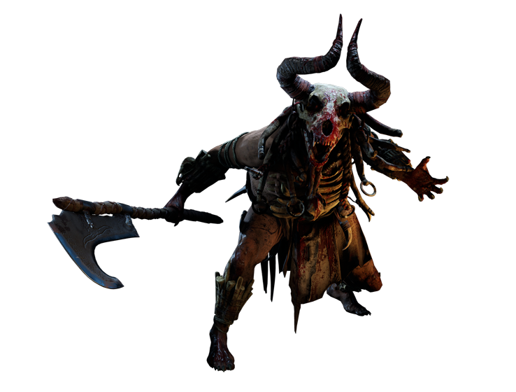
Requirements:
Less work for the animators
100% runtime simulation
Animation Blending just in case.
Notes:
And because of the animation schedule and the amount of characters we had on Ryse. We were looking for a system that takes care of most if not all the secondary animations, like the dangling teeth, tails , ropes all kind of accessories
That being said, because we had universal rigs(used in cinematics and in-game), we wanted some animation control. I remember this time when the cinematics director wanted the teeth accessories on one of the barbarians to move away from the camera or something like that on one specific shot, but the settings on these teeth were working pretty fine in-game and the other cinematic shots. This is the time where we had to blend with animations to avoid breaking the setup in the rest of the game.

Slide 12
Physicalized Joints
Pendula
Massive sphere
Fixed Rod
Changes orientation of joint
Constrained by cones types
Good for accessories, hair and ropes
ClickMe
ClickMe
Springs
Massive sphere
Elastic rope
Changes translation of joint
Constrained by a scalable spheres
Good for body fat simulations and slide effect
ClickMe
Notes:
In Ryse we simply use the properties of pendula & springs. Written by Ivo Herzeg (R&D programmer)
With the right assets and setup we got pretty impressive results.
Pendulum (click on the pendulum video)
A pendulum is basically a sphere with mass connected to a fixed rod which in turn is connected to a pivot point. Here we have a normal “free-hanging” pendulum without any constraints. If we push it a bit, it will swing back and forth in any direction, until air-resistance or another force will slow it down. In the rest-position the sphere is hanging directly downward.
We can change the length of the rod, which has a big impact on the swinging and on top of that we can modify the free swinging by physical parameters like mass, gravity, damping and stiffness.
Finally we can constrain the swinging with a cone or with hinge planes (which gives us a 2D swinging in 3D) or with half-cones.
To use on character animation, we attach the pendulum to a joint on the skeleton. We can tweak all these parameters while we see the animated character in the editor.
Spring (click on the spring video)
A spring is defined as a sphere with mass connected to an elastic rope. The concept is pretty similar to a bungee rope.
There is always a counter balance between elasticity, mass and gravity. If we make the elasticity too high, gravity will pull the sphere down. If we reduce elasticity, the sphere will gravitate toward the origin.
To constrain the motion of the spring we use a special sphere that allows us to scale both half-spheres independently.
That means we can deform it into an ellipsoid , or an egg , or a half-sphere .We can even create a plat plane if we scale both sides to zero (which gives us a circle in 3D) and even into a line segment.

Slide 13
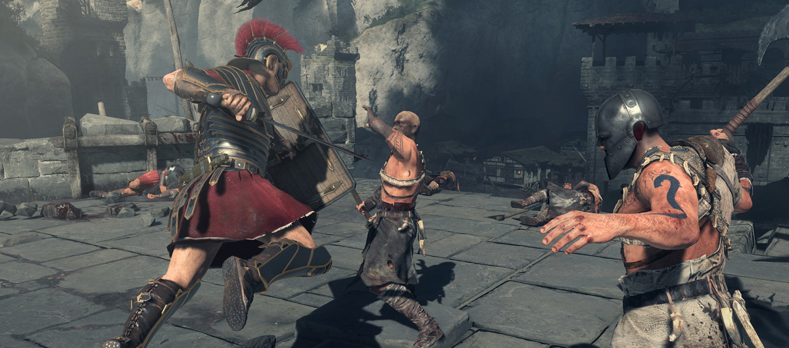
In-Game Cloth
Physicalized joints not enough
Hard to setup for a closed mesh like a skirt
New in-game cloth System
Lots of skirts prototyping
Notes:
With all the options and the results I showed using physicalized joints, we still felt that it will not be enough to use it for cloth at least with the quality we were looking for in a next Gen game plus of course using physicalized joints to setup a moving skirt is way harder than using it for a rope or a single piece of cloth. Mihai Francu (programmer) was fully dedicated for developing new in-game cloth system for Cry-engine.
With the help of Technical artists we came up with a pipeline that rely on both the setup in Maya and the Engine.

Slide 14
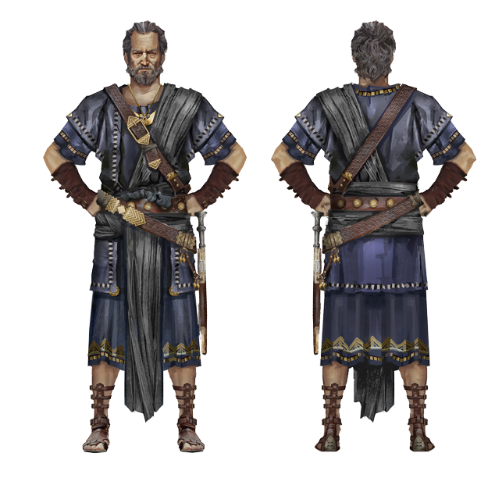
In-Game Cloth
We could not apply the simulation on the render meshes
We could not support layers
Real Time Wrap Deformer
Using a Simulation mesh
Vertex colors
Notes:
The real time process of mesh deformation is done on the CPU which is more expensive compared to GPU skinning. For that reason we could not apply the simulation on the Render mesh or support self Collision
So we came up with the idea of using a lower res simulation mesh that acts as a wrap deformer to the render mesh at run time. With vertex colors we can decide the relationship between the cloth physics and the original skinning. Black vertices never get simulated and always get their position from skinning. White vertices mean they are fully simulated and have no connection to skinning, grey vertices get pulled (sort of like a spring) towards their corresponding skinned positions. Like (input mesh attract) sounds familiar?

Slide 15
Notes:
The picture is showing the Topology of both render mesh and simulation mesh of Marius’s skirt, plus the vertex color on the simulation mesh.

Slide 16
Collisions
Phys proxies setup in Maya
Tied to the skeleton
Bad coverage
Slow Process
Notes:
Setting up the collision proxies in Maya using the phys/hit proxies Limited to the skeleton Characters sharing the same skeleton have to use the same collision proxies. Bad coverage of the body volume, and the process of exporting to the game and tweaking back in Maya was very slow.

Slide 17
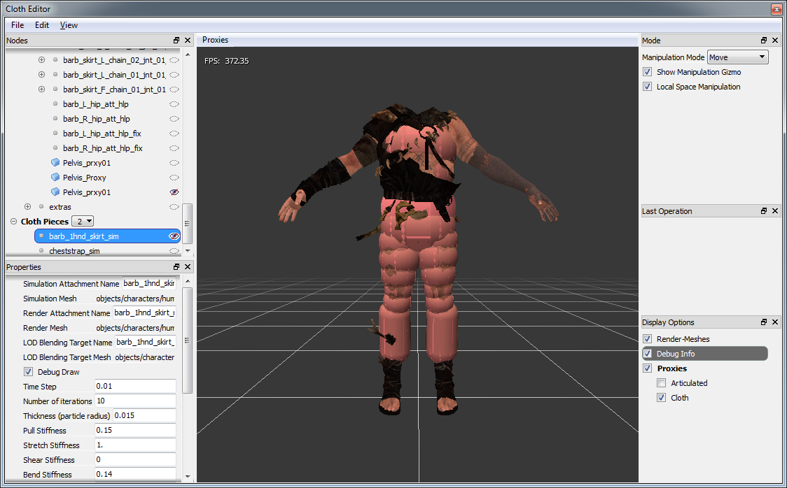
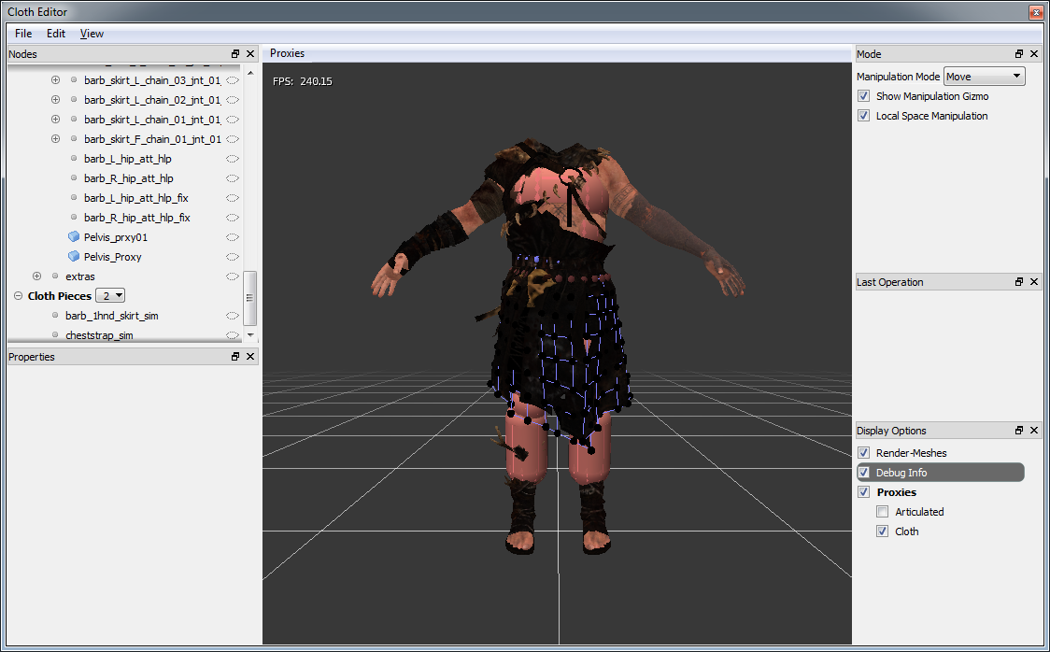
Cloth Editor
Phys Files
Separate Cloth Collision proxies
Multiple Proxies
Real time Feedback
Debugging options
Notes:
Video of the cloth editor in Cry Engine The Cloth Editor was a break through for us(Technical artists), developed by Evgeny Andreeshchev (UI programmer) the cloth editor allowed us to setup the cloth with double or even triple the speed we used to take.

Slide 18
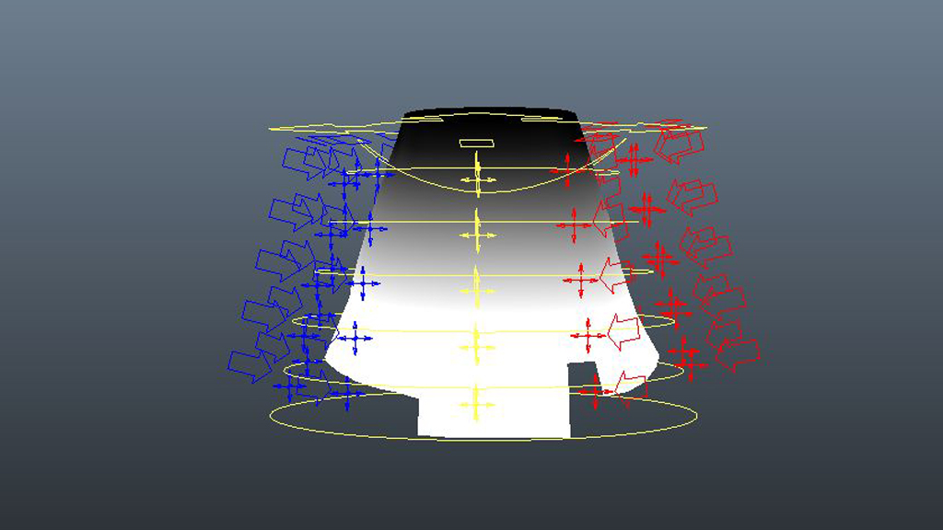
The Skirt Rig
60 Joints
Follows Character Movement
Animation Control
Layers Of Deformations
Scalable
ClickMe
Notes:
Video of the rig With the type of animations we had, 180 degree turns, big leaps and evades, it was still hard to keep cloth from breaking in certain situations. So we had to come up with a rig that would allow the animators to fix those animations and blend with the cloth physics with a blending attribute.

Slide 19
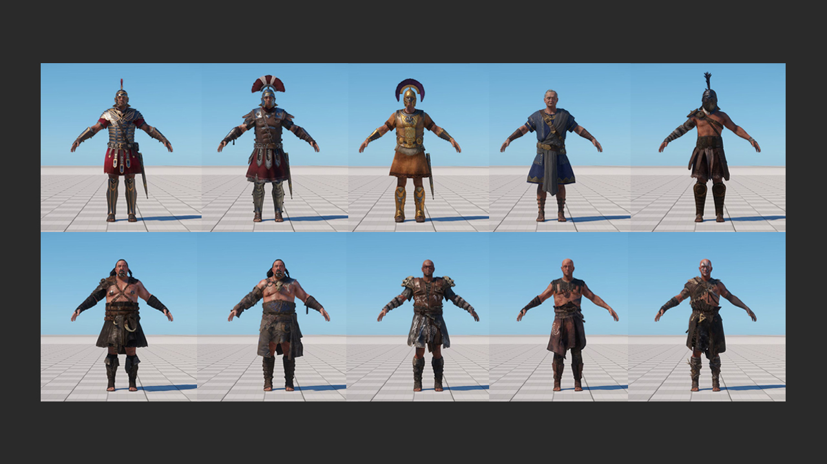
Notes:
10 unique skirts using the same skirt setup just customized to fit the size. Around 50 character variations in total with skirts running on the same rig.

Slide 20
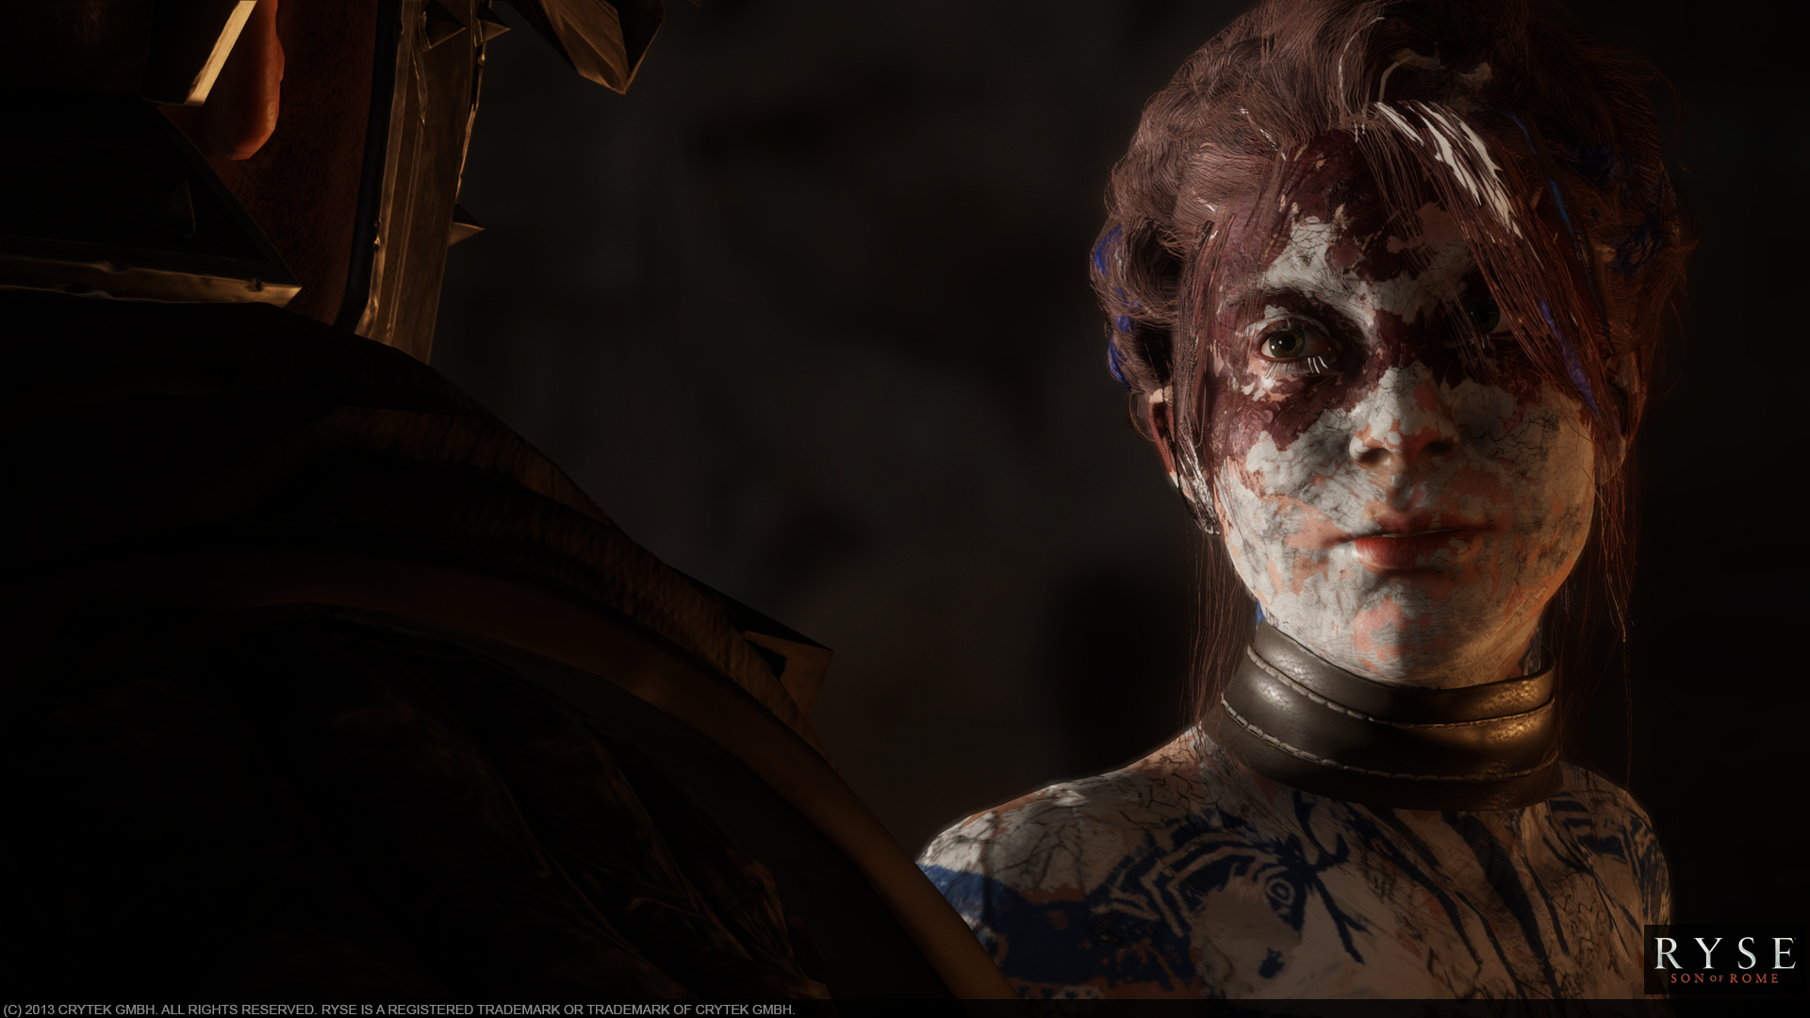
Many Thanks
Chris Evans, Ivo Herzeg, Harald Zlattinger, Alexander Raab, Mihai Francu, Bogdan Coroi, Jerome Charles, Evgeny Andreeshchev, Sascha Herfort, Franco Bresciani, Axel Gneiting, Florian Reschenhofer, Abdenour Bachir, Chris Goodswen, Min-Chih Wang, Hyejin Moon, Lars Martinsson and Many more….

